Slide 1

FRAGMENTS

Slide 2




BASICS

Slide 3

HOW DEEP IS YOUR LOVE?
Self-acceptance
Trial
Past regrets
Working through
Reassembly

Slide 4

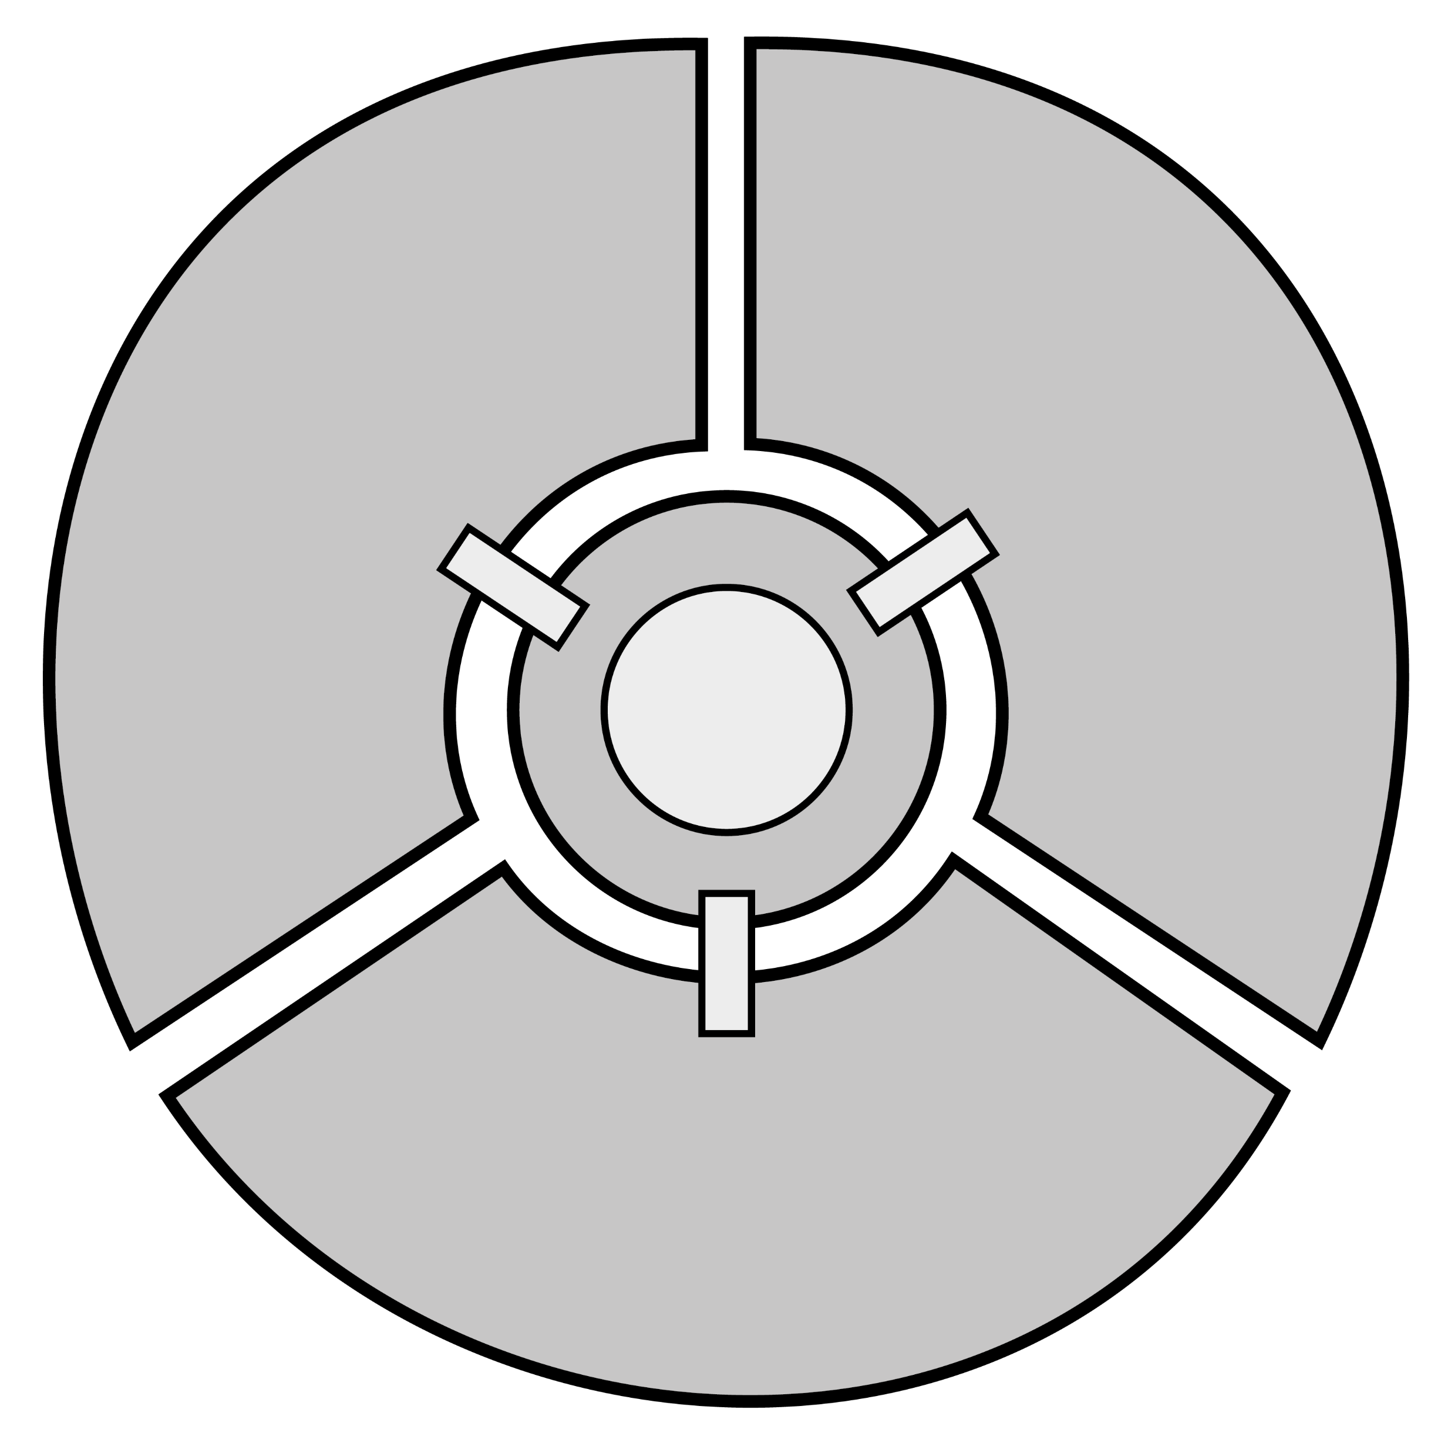
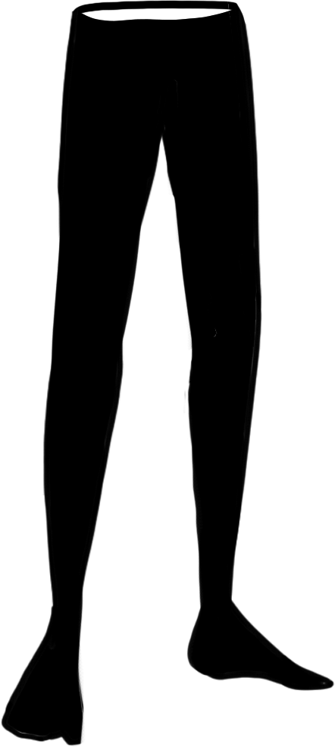


STRUCTURE
3
1
HUB
2

Slide 5


GAMEPLAY
Enter
Unlock
Analyze
Learn
Solve
Collect

Slide 6

GAMEPLAY
Wall run
Push objects
Hook

Slide 7



NARRATIVE

Slide 8


NARRATIVE
Running
away
Cowardice

Slide 9



TECHNICAL APPROACH
Decoupled systems
Technical debt

Slide 10
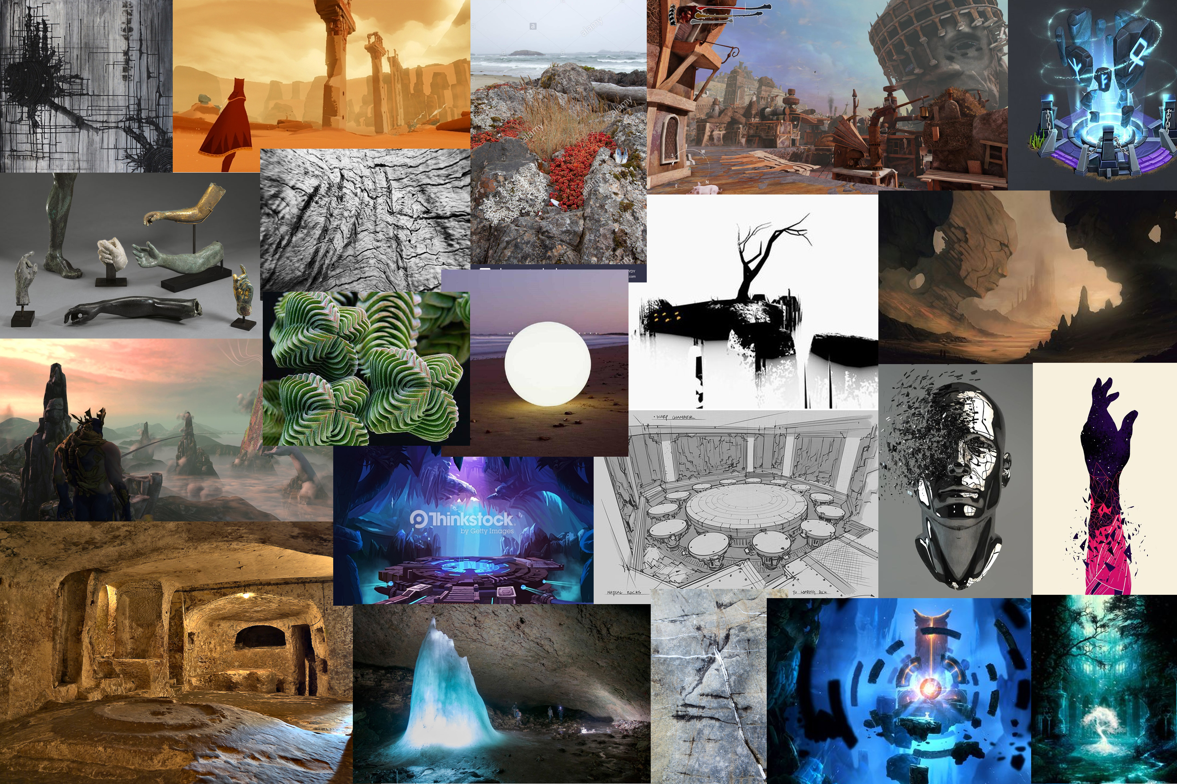
Art

Slide 11

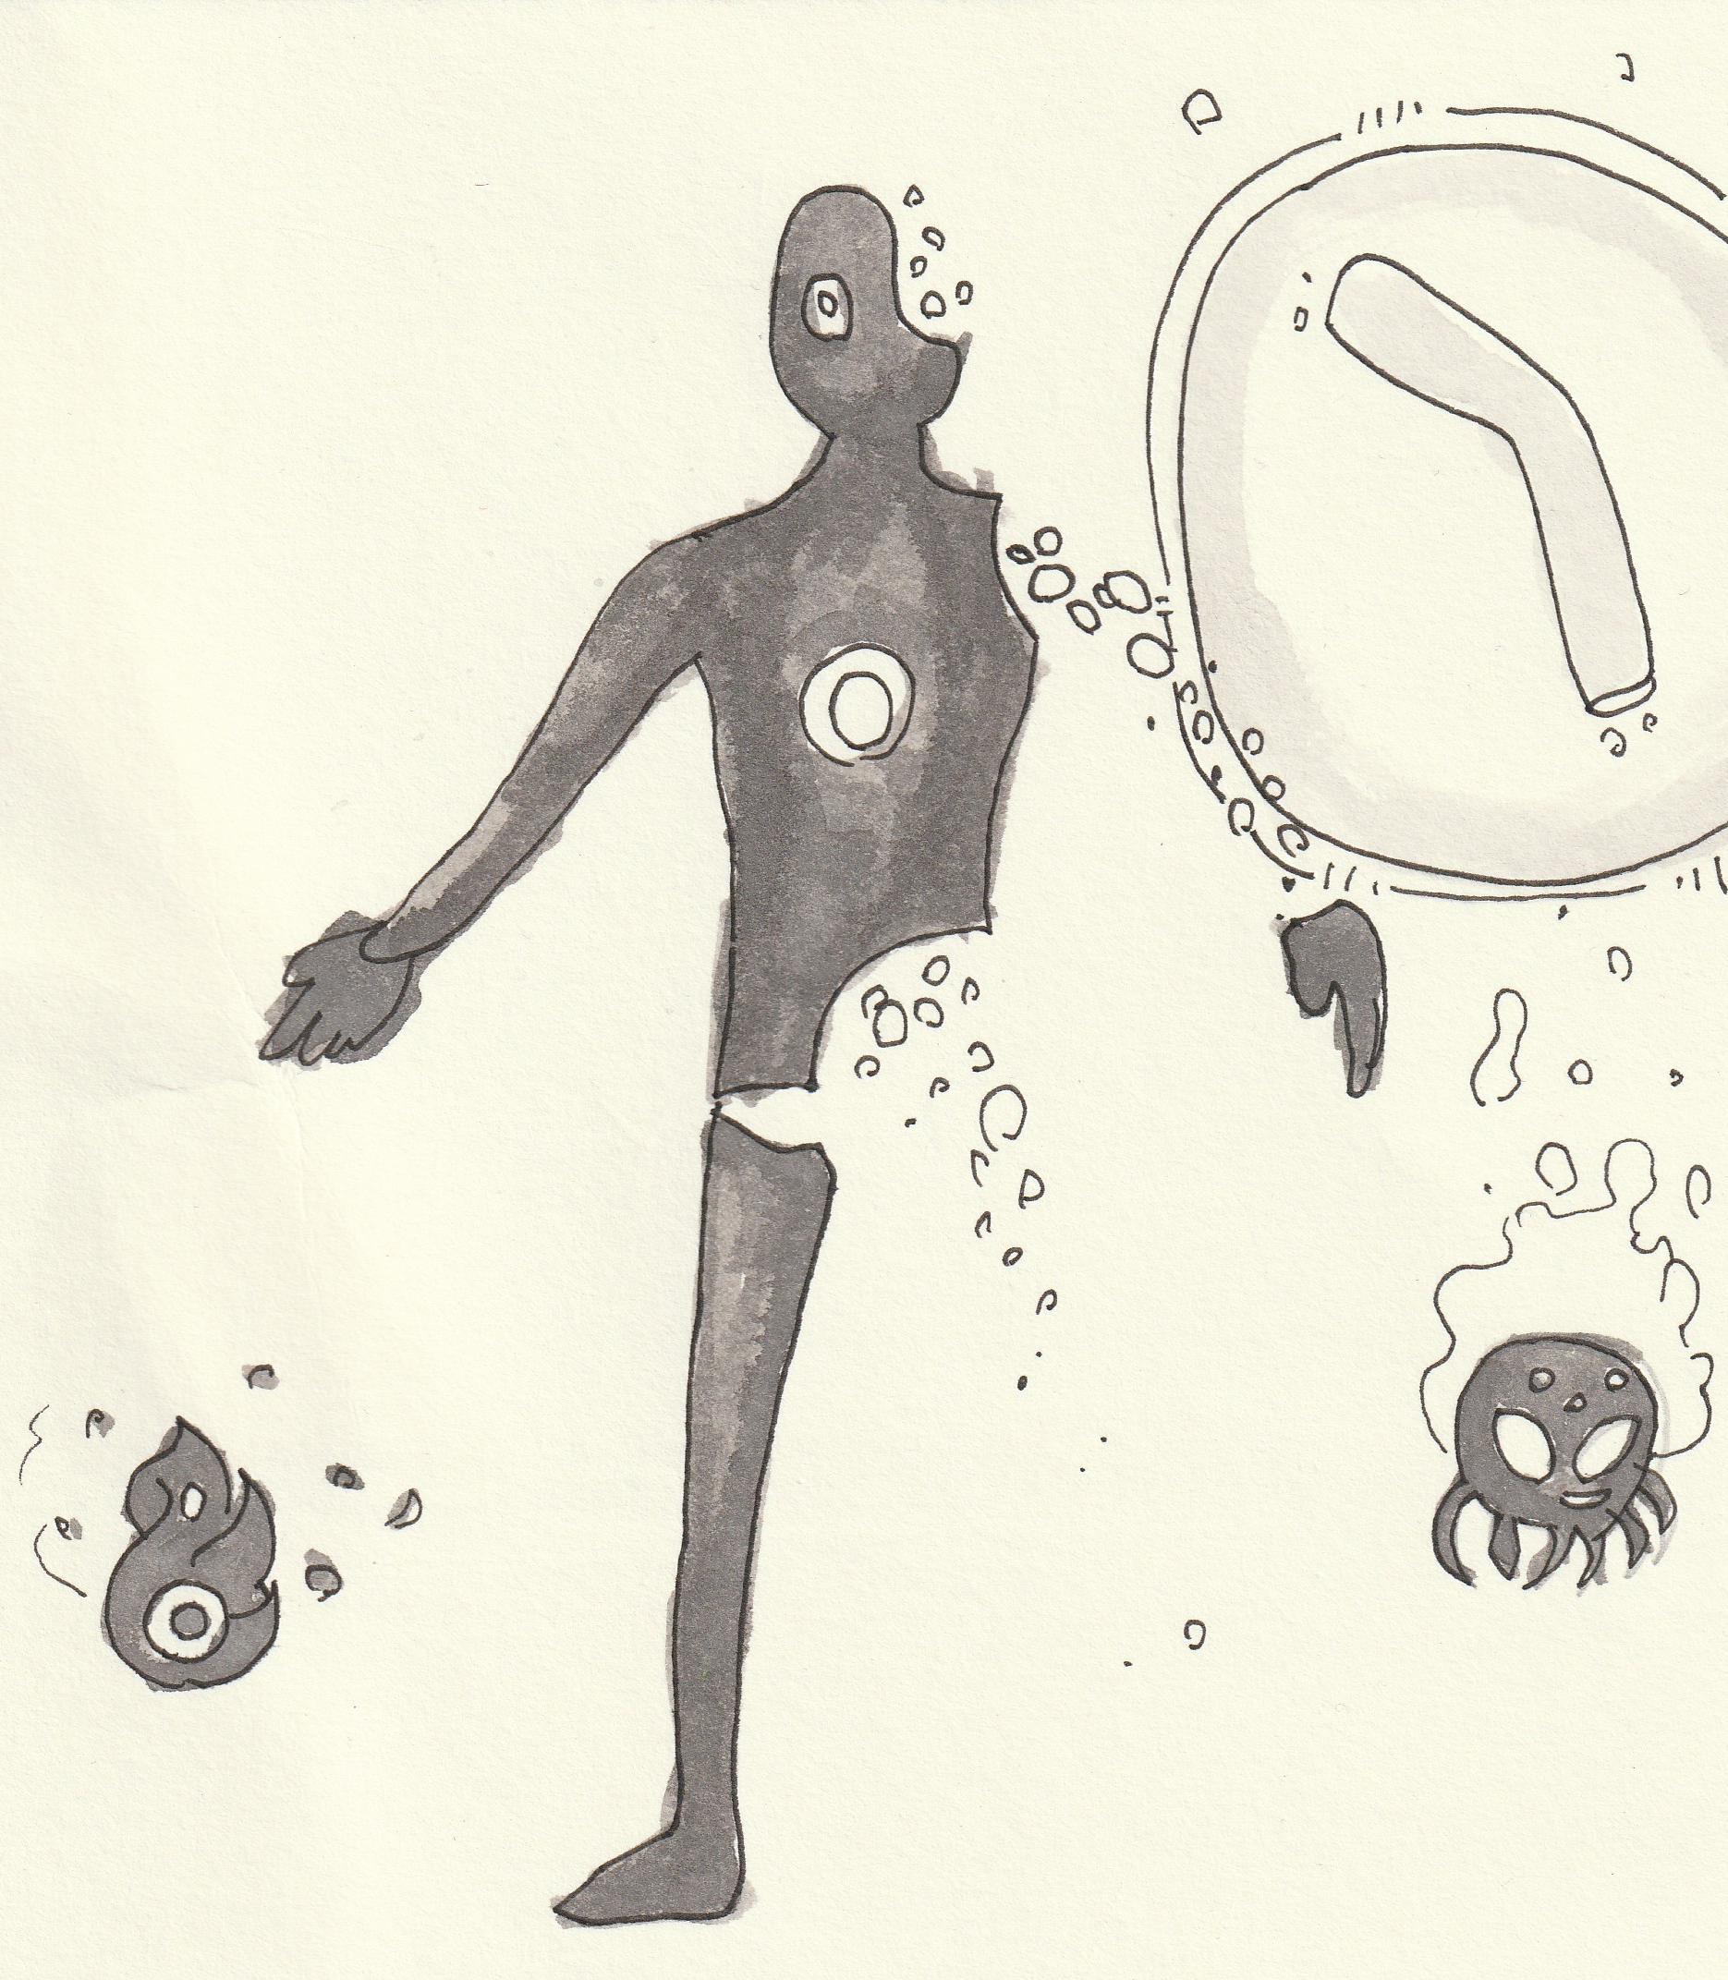
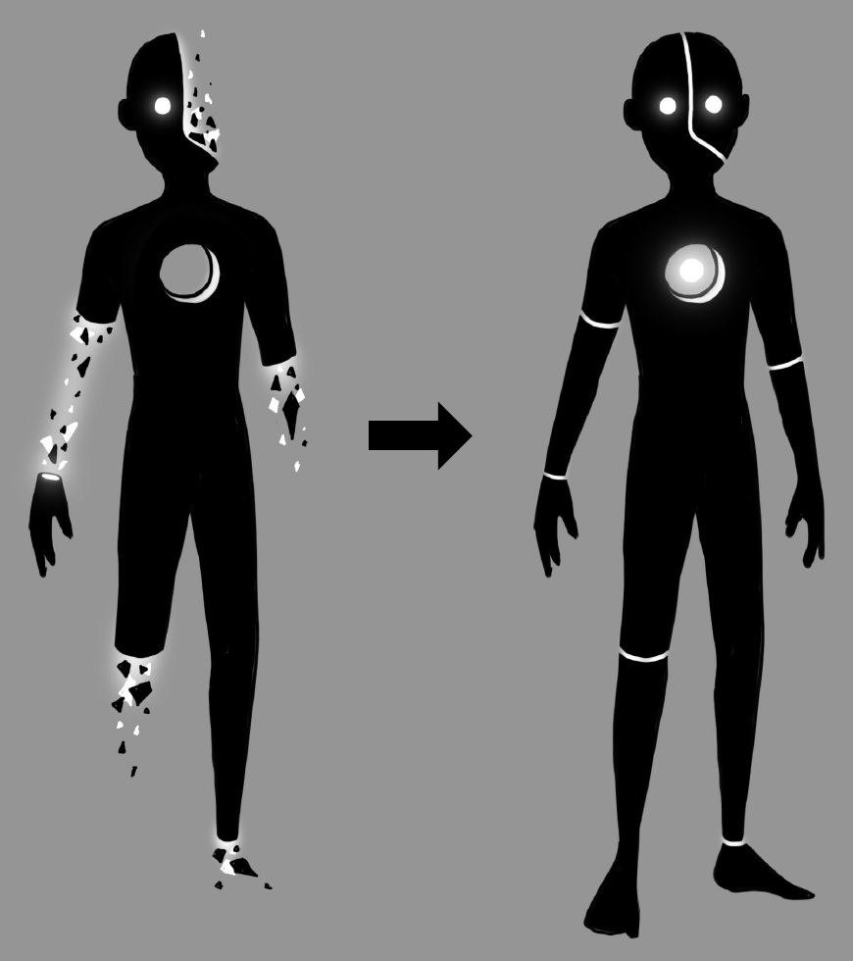
Art

Slide 12
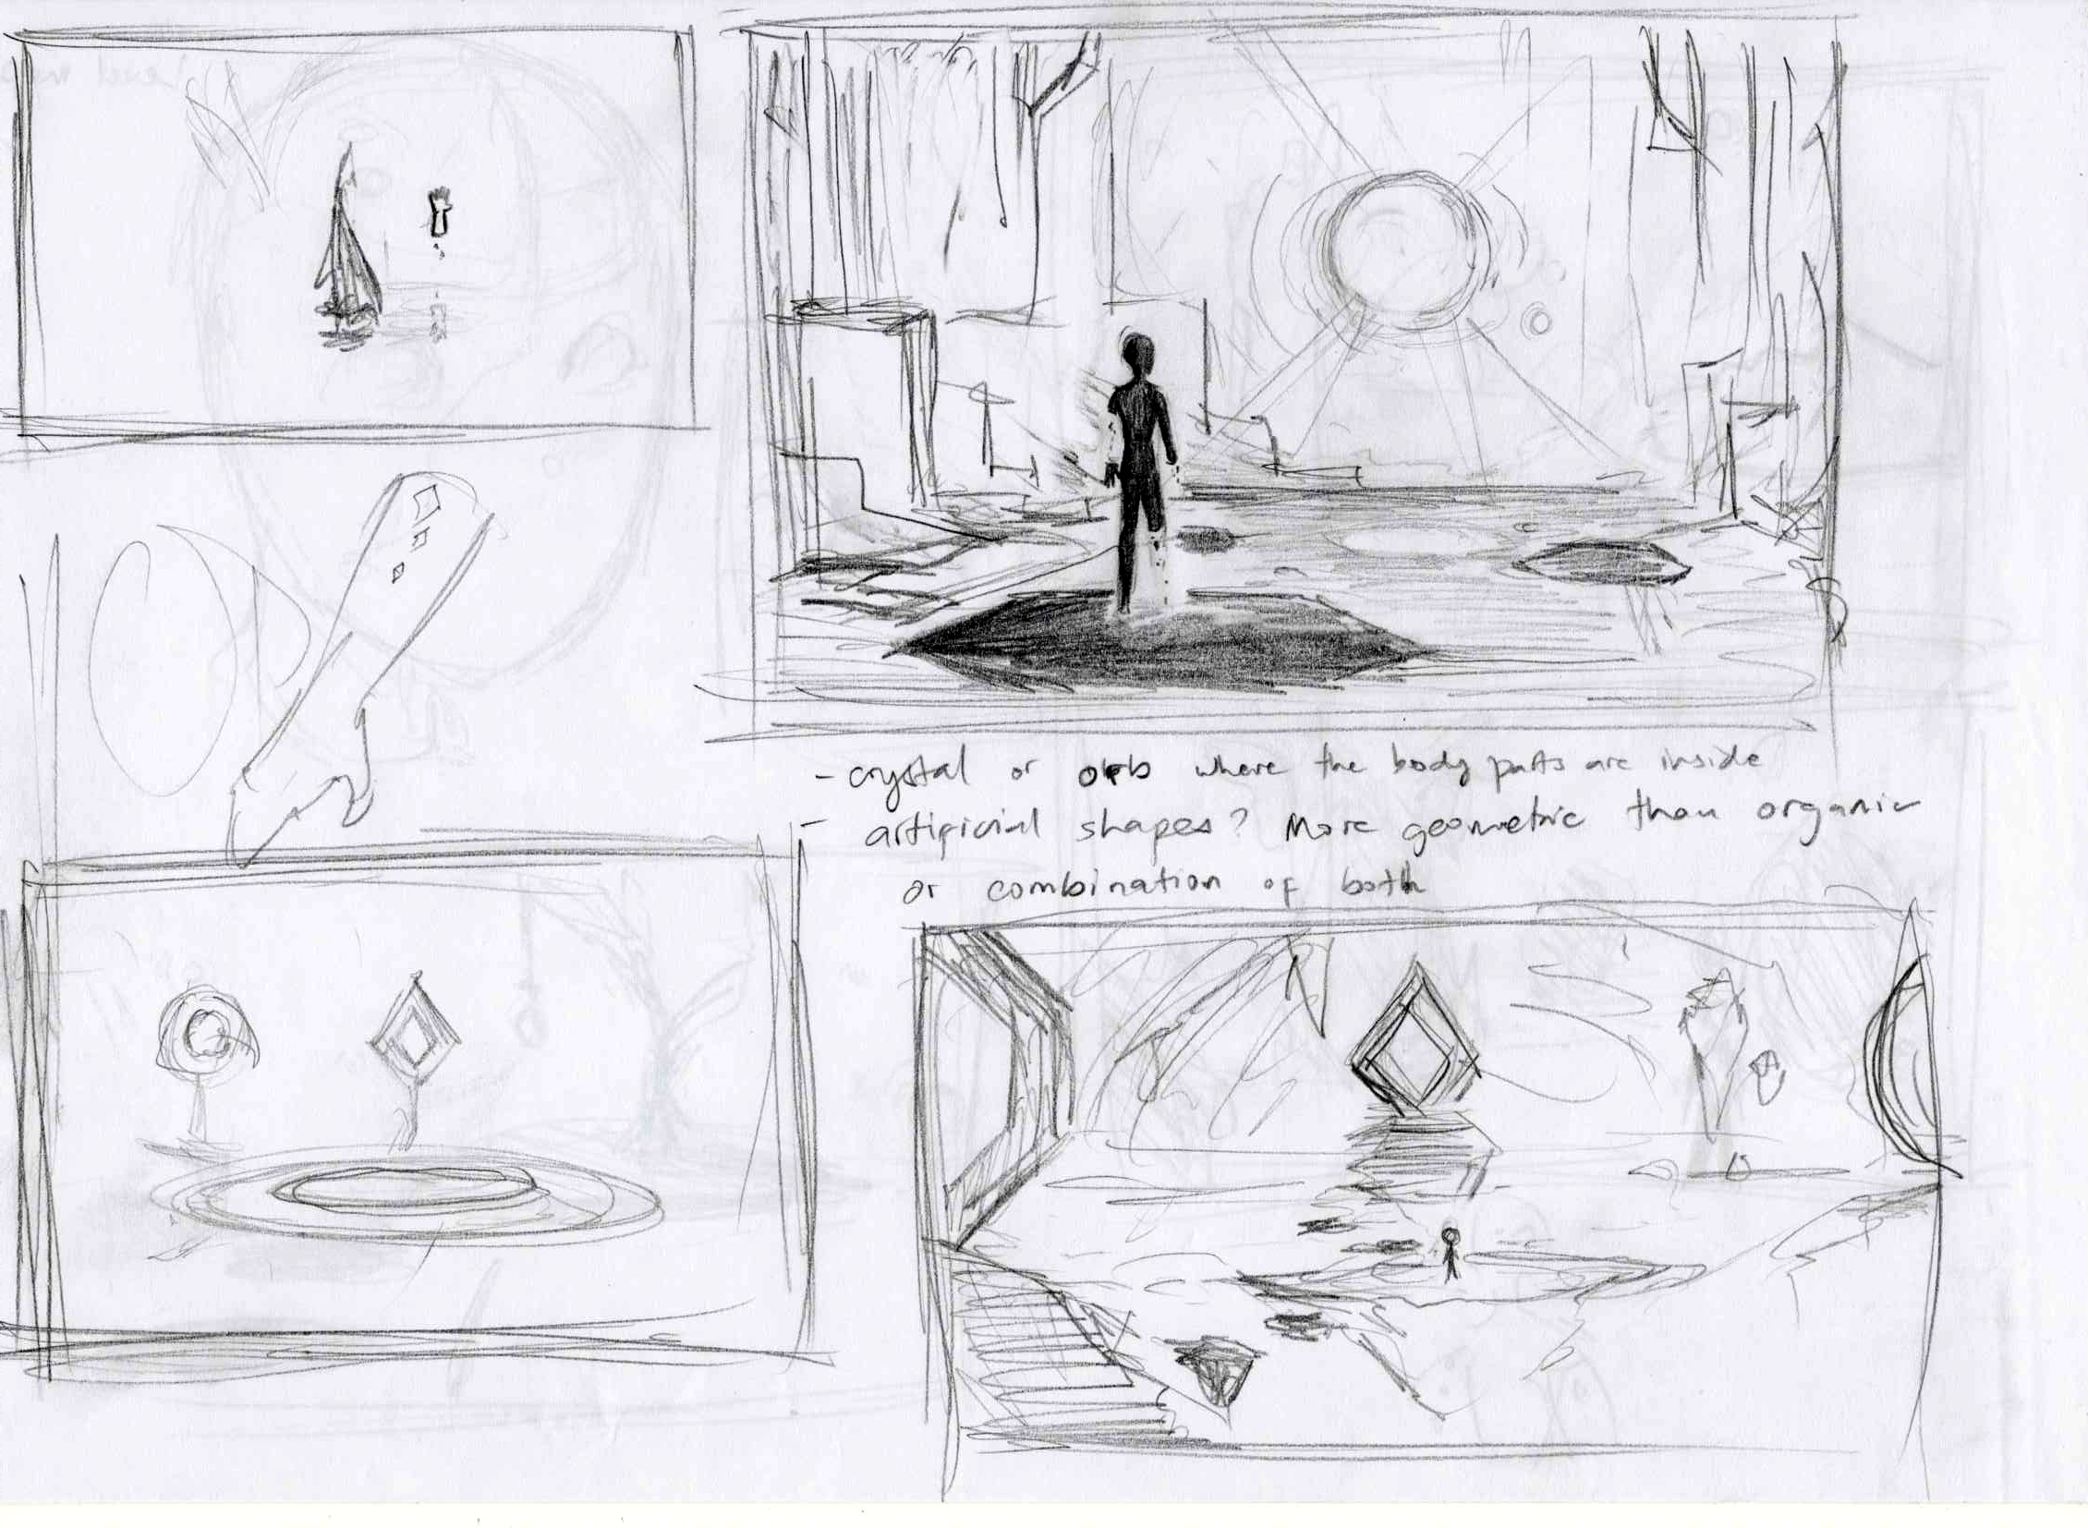
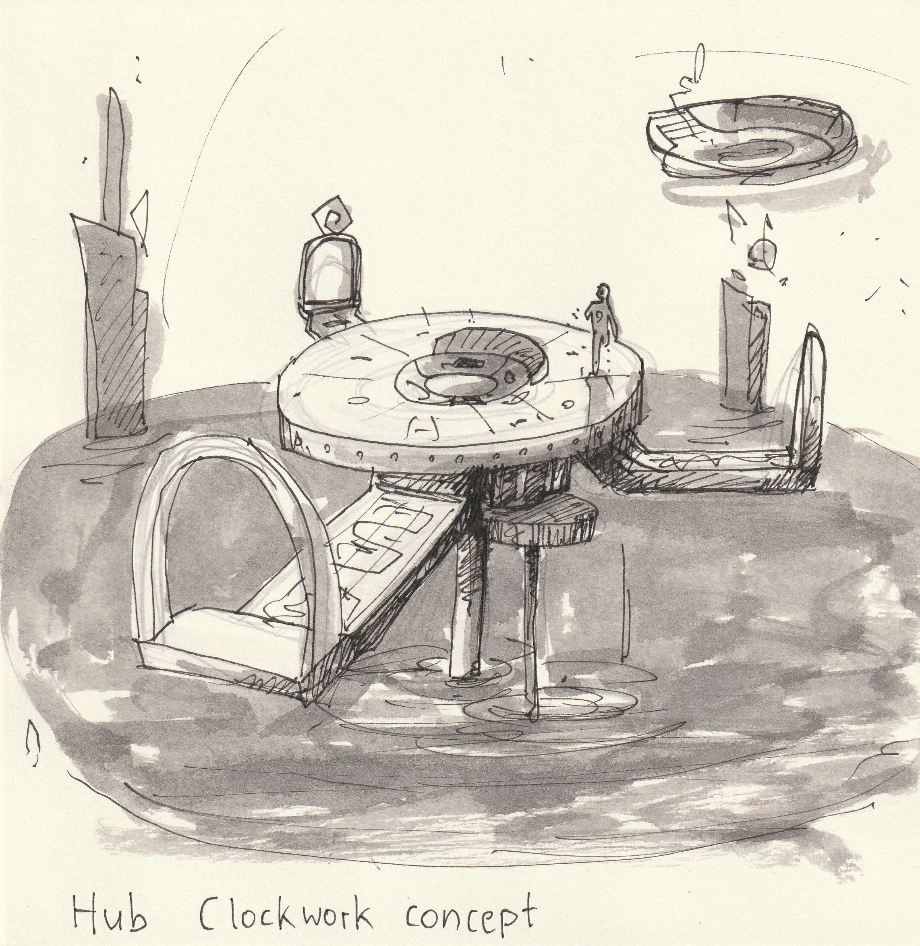
Art

Slide 13
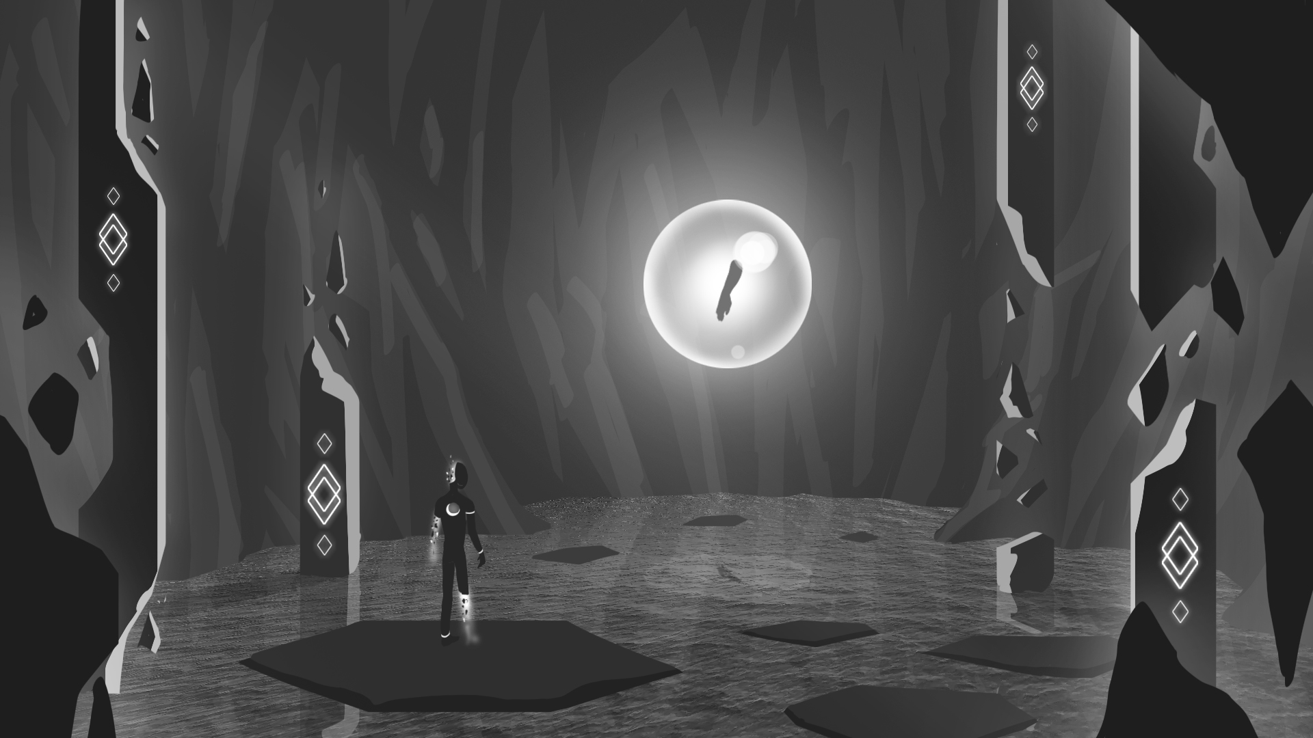

Slide 14
RIPOMATIC

Slide 15

THANK YOU!
Alexander Gerhards
Lead / Artist
Lars Kalthoff
Designer
Trixia Quinzon
Artist
Daniel Baracotti
Designer / Sound
Thiago Morano Gerding
Programmer

